Slide 1

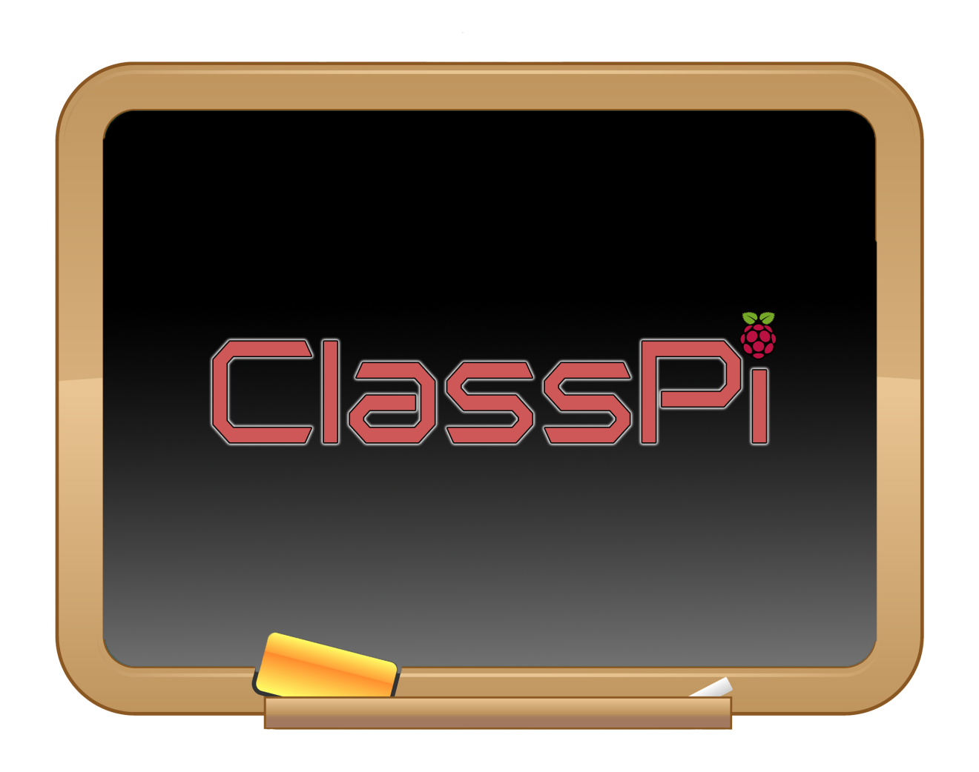
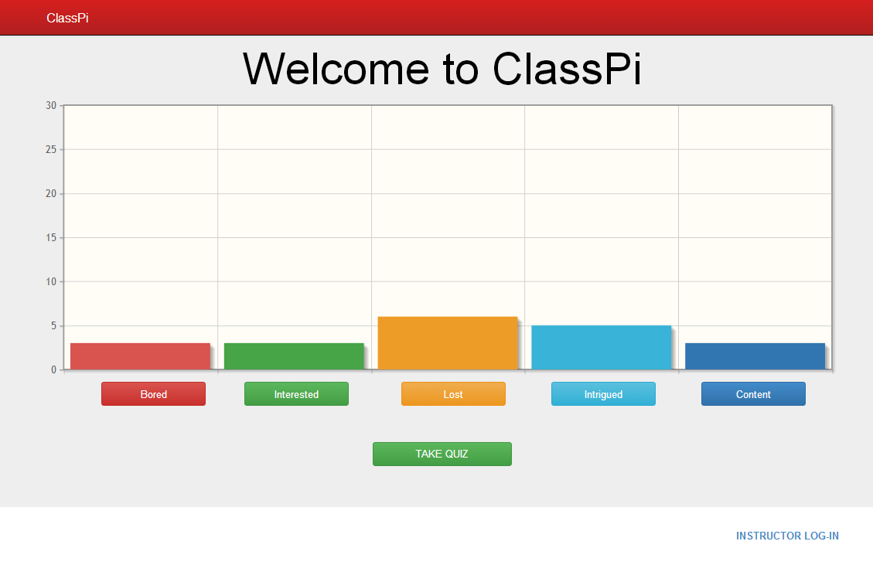
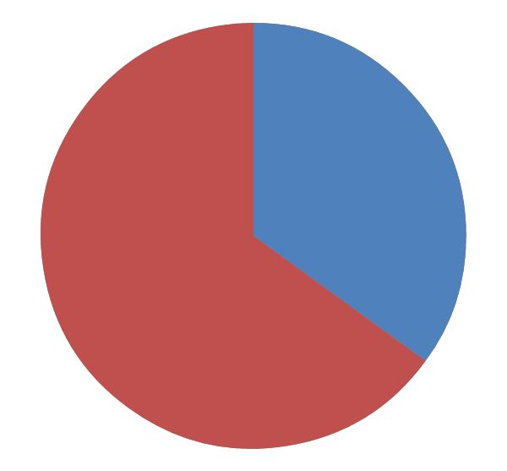
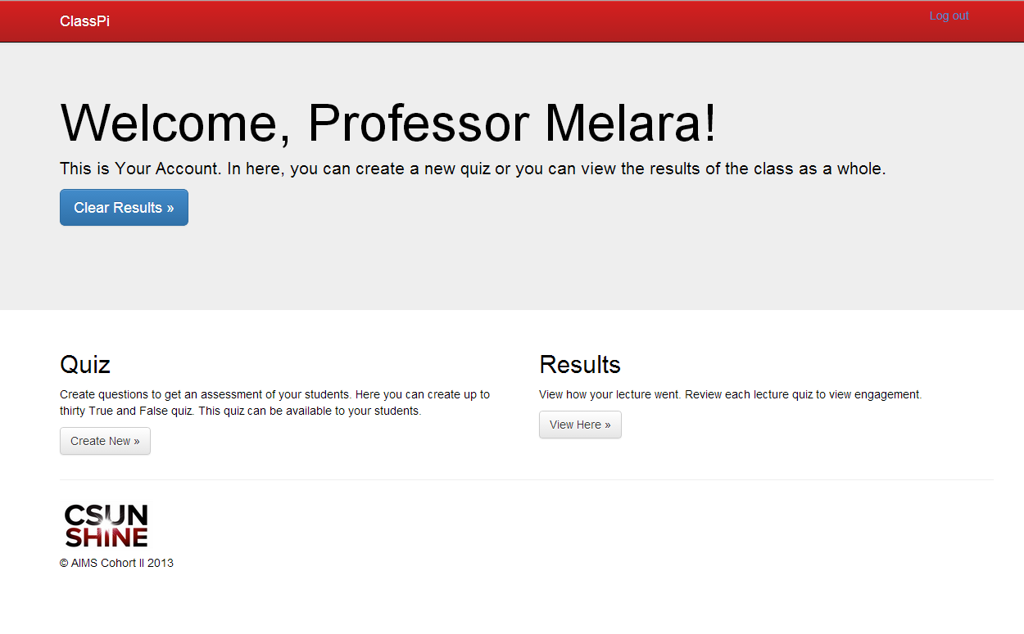
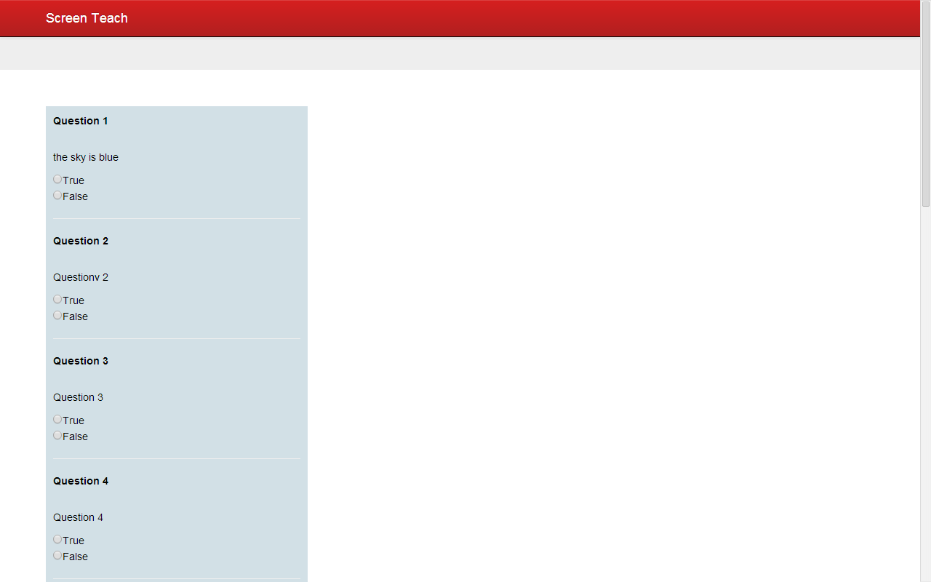
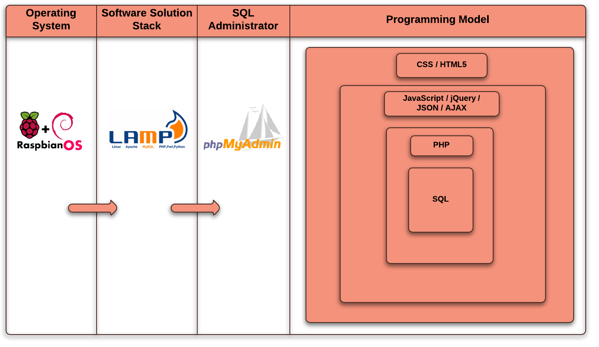
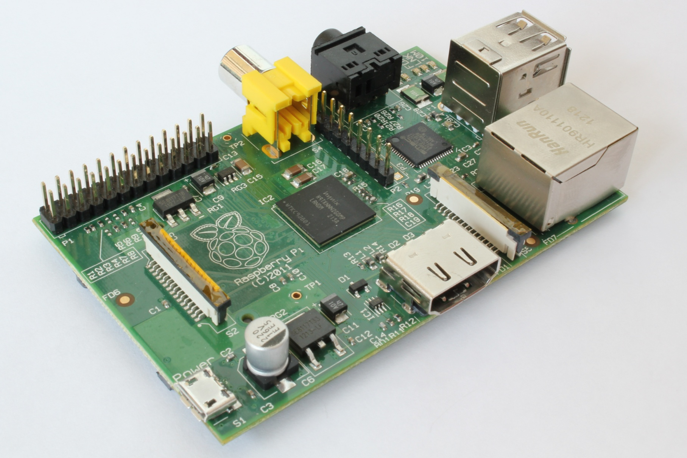
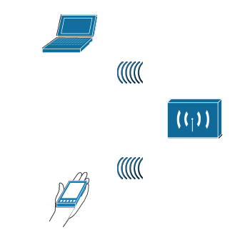


An Interactive Classroom
Management Tool: ClassPi
Oliver Barreto, Karoon Gayzagian, Ernie Ledezma, Paulo Osuna, Edward Salcido, Tatevik Sardaryan, Katren Ter-Oganesyan,
Felix Villa, Juan Zepeda - Computer Information Technology and Computer Science, California State University Northridge
Gloria Melara, Faculty Mentor, California State University Northridge
Abstract
Motivation
Tools
The purpose of ClassPi is immediately obvious to all college students – creating a better system of communication between the instructor and the student. There are countless cases in which students are unable to grasp the concept of a topic, or instructors cannot gauge the level of understanding of their students. ClassPi serves as the mediator, to bridge the gap between instructor and student. ClassPi allows the instructor to post up questions about his topic for the class to see. Students are able to respond to those questions and give feedback about the instructor’s topic. Students’ answers are made immediately visible to the instructor by means of graphs. This provides the instructor with fresh, live information regarding students’ understanding of the course material. ClassPi runs on a Raspberry Pi server, which provides an ample amount of mobility. Students are able to access ClassPi via Wi-Fi enabled devices. Features for instructors include Instructor View, where they are able to upload questions before the start of the class, to see the results of the quiz, and to see how focused the students are on the topic. Student features include a quiz-taking page, and a feedback field. These features in ClassPi help modernize the traditional classroom to new technologies, which will result in better student-instructor communication and overall positively impact education.
Student-Teacher Interactions
The need for students to communicate their thoughts and ideas to the instructor directly
To create a venue for real-time student-teacher communication, without interrupting the class
College students are bored in class about 28% of the time.
Real-time feedback homepage
ClassPi provides real-time communication between the student and professor. To the student it provides a venue for communication with the professor via Wi-Fi enabled devices without interrupting class. Students are able to gauge the reactions of their peers in the classroom anonymously, creating a more comfortable learning environment. The professor can adjust his or her lecture based on ClassPi feedback: real-time graph and assessment. The ClassPi has the potential to provide objective research on education.
Group Motivation
Our desire to engage in a project where several different skill levels are necessary to succeed
The Current State of Technology in the Classroom [Infographic]
The levels
Software engineering Process
Conclusion
Hardware Experiences
ClassPi is flexible, meaning it can support any device connected via Wi-Fi with a web browser
Can be used for various types of classroom lectures
Setup is simple and quick with no technical expertise required – you simply just plug it in to power
The actual hardware is very lightweight and it is able to broadcast its own network and host an internal website that distributes the software content of the project
Overall, the project was a success because we were able to bring together a group of students, whose knowledge and experience varies greatly, to develop a prototype that betters the college experience for more students like ourselves
We were able to modify a USB Wi-Fi dongle and use it as a Hotspot to broadcast a network for clients to connect
Extensive research was required to fine-tune many details, such as security configurations, wireless encryption and the hardware chipsets
Configuration of LAMP stack system
Software Diagram
Professor’s Welcome Screen
Future Implementations
Distribute worldwide as an open-source project
Localization support
Host student lecture material
Students’ ability to provide feedback on specific lecture topics
Browse lecture history
Network Diagram
Student Quiz View
SSID: ClassPi
Address: classpi.local
Encryption: WPA2
Chipset: Realtek
Wireless Standards: IEEE 802.11n (draft), IEEE 802.11g, IEEE 802.11b
USB2.0/1.1 interface
Data Rate: 802.11n: Up to 150Mbps (downlink) and up to 150Mbps (uplink), 802.11g
Radio Channel: 6
(Universal Domain Selection)
Acknowledgements
AIMS²
The Raspberry Pi itself is a unique feature because it is portable and inexpensive
HSI-STEM
Funding: HSI-STEM grant by the U.S. Department of Education
Contact Info:
Gloria Melara
Gloria.melara@csun.edu
HSI-STEM

Slide 2






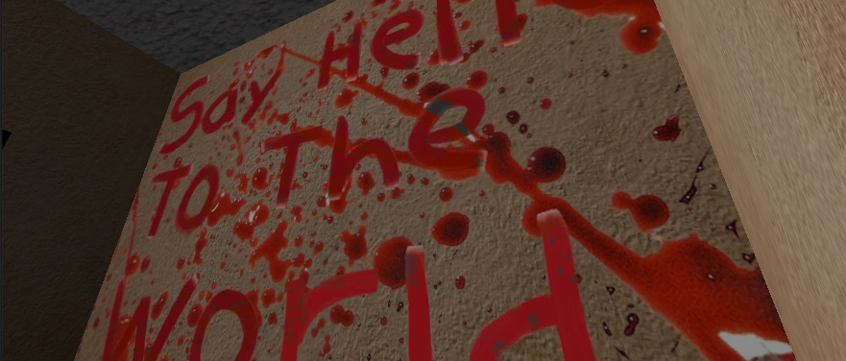

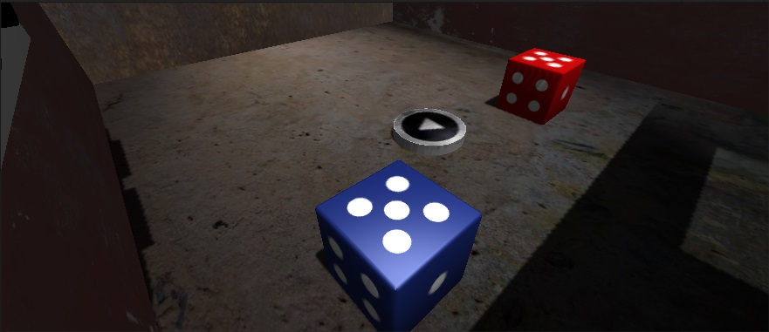
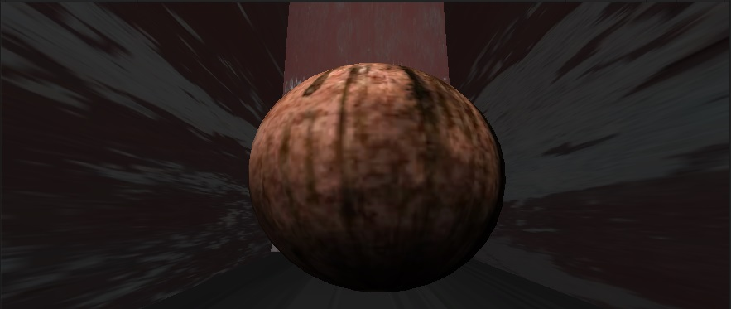
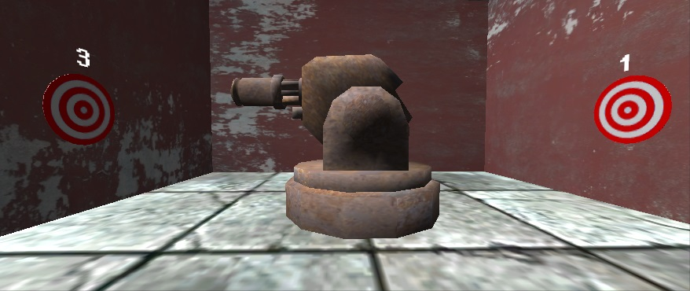
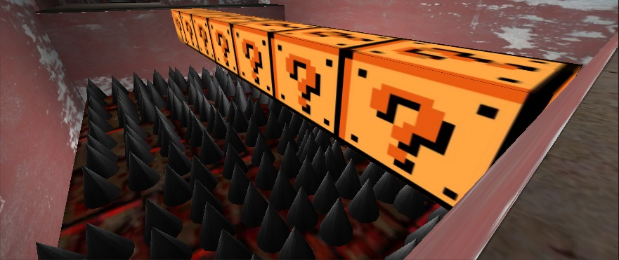
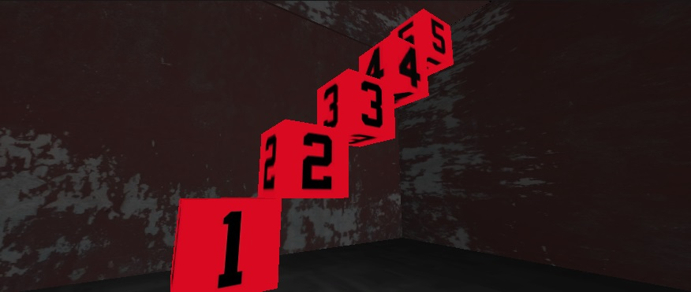
Codeescape:
The Funner Way to Learn Java
Team Members: Dani “Cristian Ronald0” Odicho, Tariq “Big Booty” Rafiq, Ernie “With Da Fly Fade” Ledesma, Oscar “GoodLookingAss Self” Lugo, Jose “da Homie” Pech, Kasun “Remember Da Name” Hettiarachchi , Abel “Baby Daddy” Lawal, “Asian” Joseph Pena
Goals Of the Project
Motivation
Development Tools
The main goal of the CodeEscape project was very simple; to make programming accessible and attractive to a different audience. It is very hard to market programming and the discipline of computer science in general to younger audiences. It does not appeal to them, as for the most part this audience does not yet possess the logical and analytical skills to fully grasp the fundamentals of programming. CodeEscape is a fun but challenging way to introduce this audience to the basic concepts of programming. As the player advances through the game they will learn everything from the simple “Hello World” program, to more advanced and theoretical concepts such as Object Oriented Programming. The game also focuses on the intangible elements of coding such as nomenclature and indentation amongst others, all key elements of good style. These lessons are embedded in the scary and engaging world that CodeEscape is set. The player must advance through 10 levels, each a locked room that can only be opened by programmatically solving the room’s puzzle. The player “Jacks In” to the console object in order to obtain instructions and hints, but most importantly view and interact with Java source code. CodeEscape provides a new and interesting way to bring awareness of the true nature of programming to a completely different audience, and hopefully in time, inspire the next generation of developers.
The motivation for this project is the need to make a fun way to learn programming. CodeEscape is an informal way to learn the formal rules of programming.
Insert some pic here!
Group Motivation
Our desire to provide a fun learning experience that vastly differs from the texts and tutorials that are so often found as introductions to programming.
The creation of CodeEscape required the utilization of a variety of different tools. We used the Unity 3D game engine to do the heavy lifting of the game creation. In addition to Unity 3D we also heavily used blendr and Photoshop to get the right aesthetic look the game. This includes textures, model and animation. Monodevelop was used to create the scripts and as a general IDE. Github and google drive was used as source control mechanisms.
The Game
Software Engineering
Conclusion
In Order to complete this project we used the agile methodology. Our sprint length was two weeks. Each sprint comprised of numerous different task. From very early on we appointed certain members of the group to be product owners(Dani Odicho & Ernie Ledesma) and a scrum master (Tariq Rafiq). The scrum master would appoint tasks for every sprint, but early on the team decided to try and complete a level every sprint. After the completion of every sprint the product owners would review the game and see if it aligned to the original goals of the project. Then we would take their feedback and then use it to guide the development of the game. We kept track of the progress of each sprint using the MIT schedule, which allows us to create Sprint Burndowns. Using these burndowns we were able to monitor productivity and alter the schedule in order to make sure that the optimal progress was achieved every sprint.
CodeEscape is a fully functional game, with 10 unique fully playable levels. Each level introduces and explains a different programming concept.
The game is robust having being developed with a powerful game engine and is very easy to install.
The game responded well to testing, and it has the potential to be a teach tool or a study aid for introductory programming classes
Overall the project was a success as we fulfilled the goals and completed the goals that we had set at the start of the project. The project took on a life of its own as it progressed and I think this game has turned into more than the team ever envisioned.
Future Plans
These are screen shots highlighting some of the elements found in the game. All of these elements either add to the “horror code” theme of the game. Or they are part of puzzles each used to illustrate a different aspect of coding fundamentals. (Maybe add captions or descriptors to the pictures.)
We plan to keep polish the artwork for the game. We focused primarily on the functionality of the game, and though the artwork currently in the game is great, there is always room for improvement.
We would like to crate a mobile version of the game, the average young person is using less time on a desktop and more on a mobile device, therefore a mobile version of this game would greatly add to its impact.
Maybe adding more levels this game covers the introductory concepts of programing but further levels could cover intermediate to advanced concepts .
Notes:
Please pay attention to the names make sure that I haven’t spelt any names wrong.

